Slide 1
Victoria’s mothers, babies and children 2021
Child and adolescent mortality

Slide 2
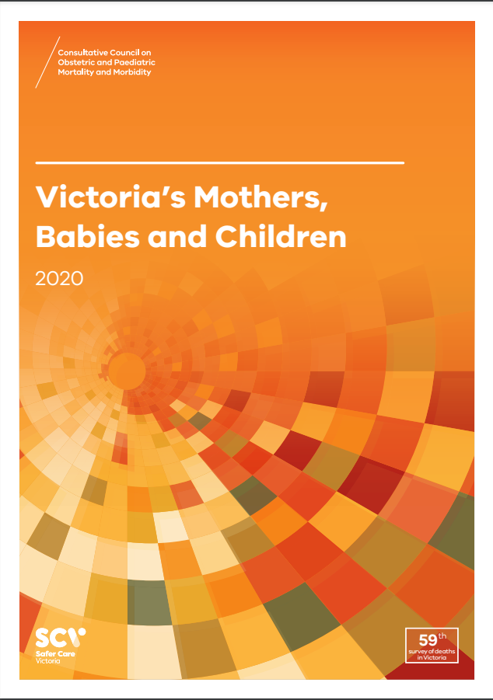
About CCOPMM
The Consultative Council on Obstetric and Paediatric Mortality and Morbidity (CCOPMM) is a statutory authority appointed by the Minister for Health.
Chair: Professor Mark Umstad AM
Operates under the Public Health and Wellbeing Act 2008

Slide 3
About CCOPMM
Legislative responsibility for data collection:
Victorian Perinatal Data Collection (VPDC)
Victorian Congenital anomalies register (VCAR)
Legislative responsibility for health surveillance:
Mortality collections and review of perinatal, child and adolescent, and maternal mortality
Morbidity collections: severe acute maternal morbidity (SAMM)

Slide 4
Undertaking case reviews
CCOPMM has four subcommittees that undertake case reviews and report to CCOPMM.
Stillbirth – Chair: Professor Susan McDonald
Neonatal (0-27 days) – Chair: Professor Rod Hunt
Maternal– Chair: Assoc. Prof. Glyn Teale
Child and Adolescent (28 days-17 years) – Chair: Adjunct Clinical Associate Professor Rob Roseby

Slide 5
Undertaking research
CCOPMM conducts research itself and provides data for research purposes. The CCOPMM Research and Reporting subcommittee leads this work - Chair: Professor Caroline Homer.
CCOPMM identifies research priorities by:
analysis of our reports, data and through case reviews
collaborating with external research projects

Slide 6
Why we do what we do?
Independent oversight of all deaths and severe maternal morbidity
Highlight areas that require improvement – hospital and community
Highlight areas for further research
Inform the development of policies and guidelines
Provide advice on areas for prioritisation and investment

Slide 7
Trends and comparisons

Slide 8
Definitions - neonatal, infants and under 5yrs
Neonatal - includes all live born babies from birth to 27 days
Post-neonatal infant - includes all live born babies from 28 days to 364 days
Infant - includes all live born babies from birth to 364 days
Under 5 - includes all babies from birth up to but not including the 5th birthday

Slide 9
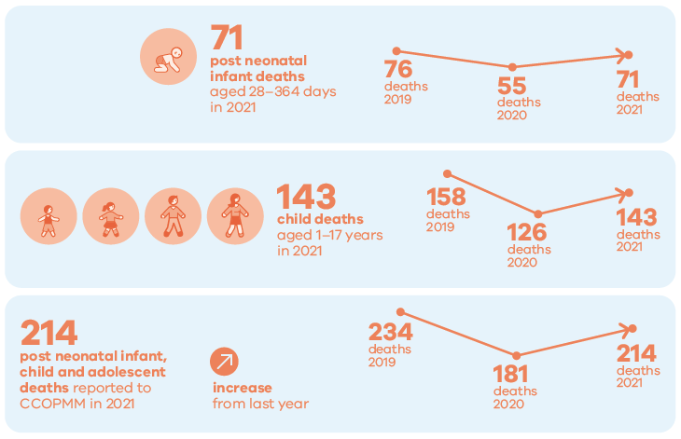
Child and adolescent deaths 2021

Slide 10
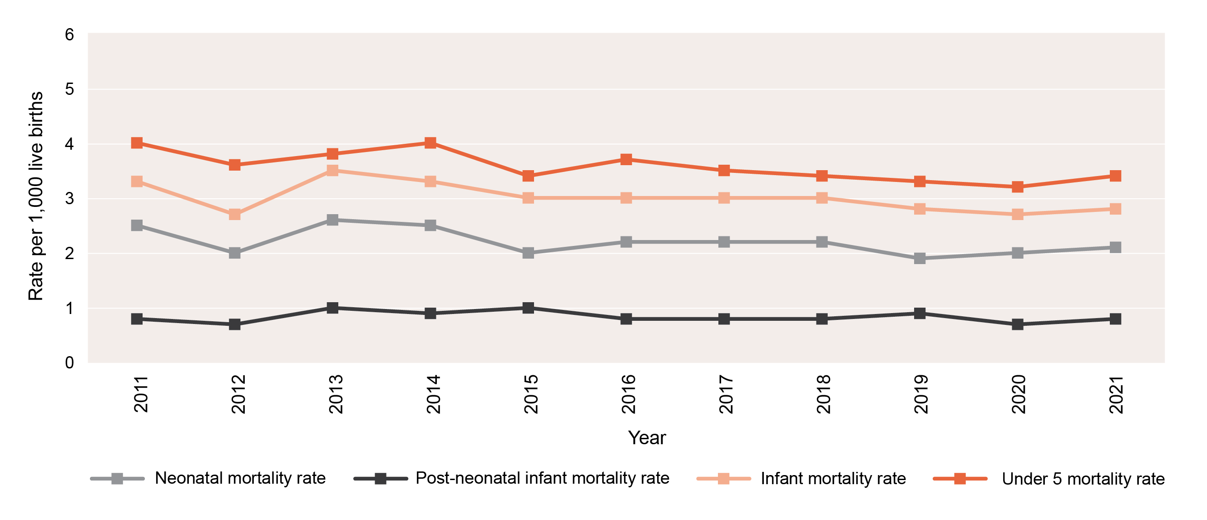
Neonatal, post-neonatal, infant and infant and under 5 mortality rates, 2011-2021

Slide 11
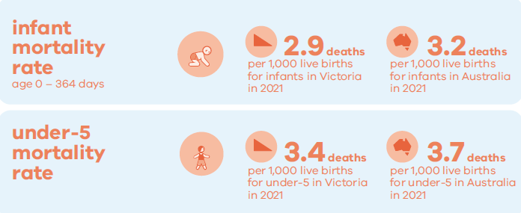
Under 5-year mortality rate

Slide 12
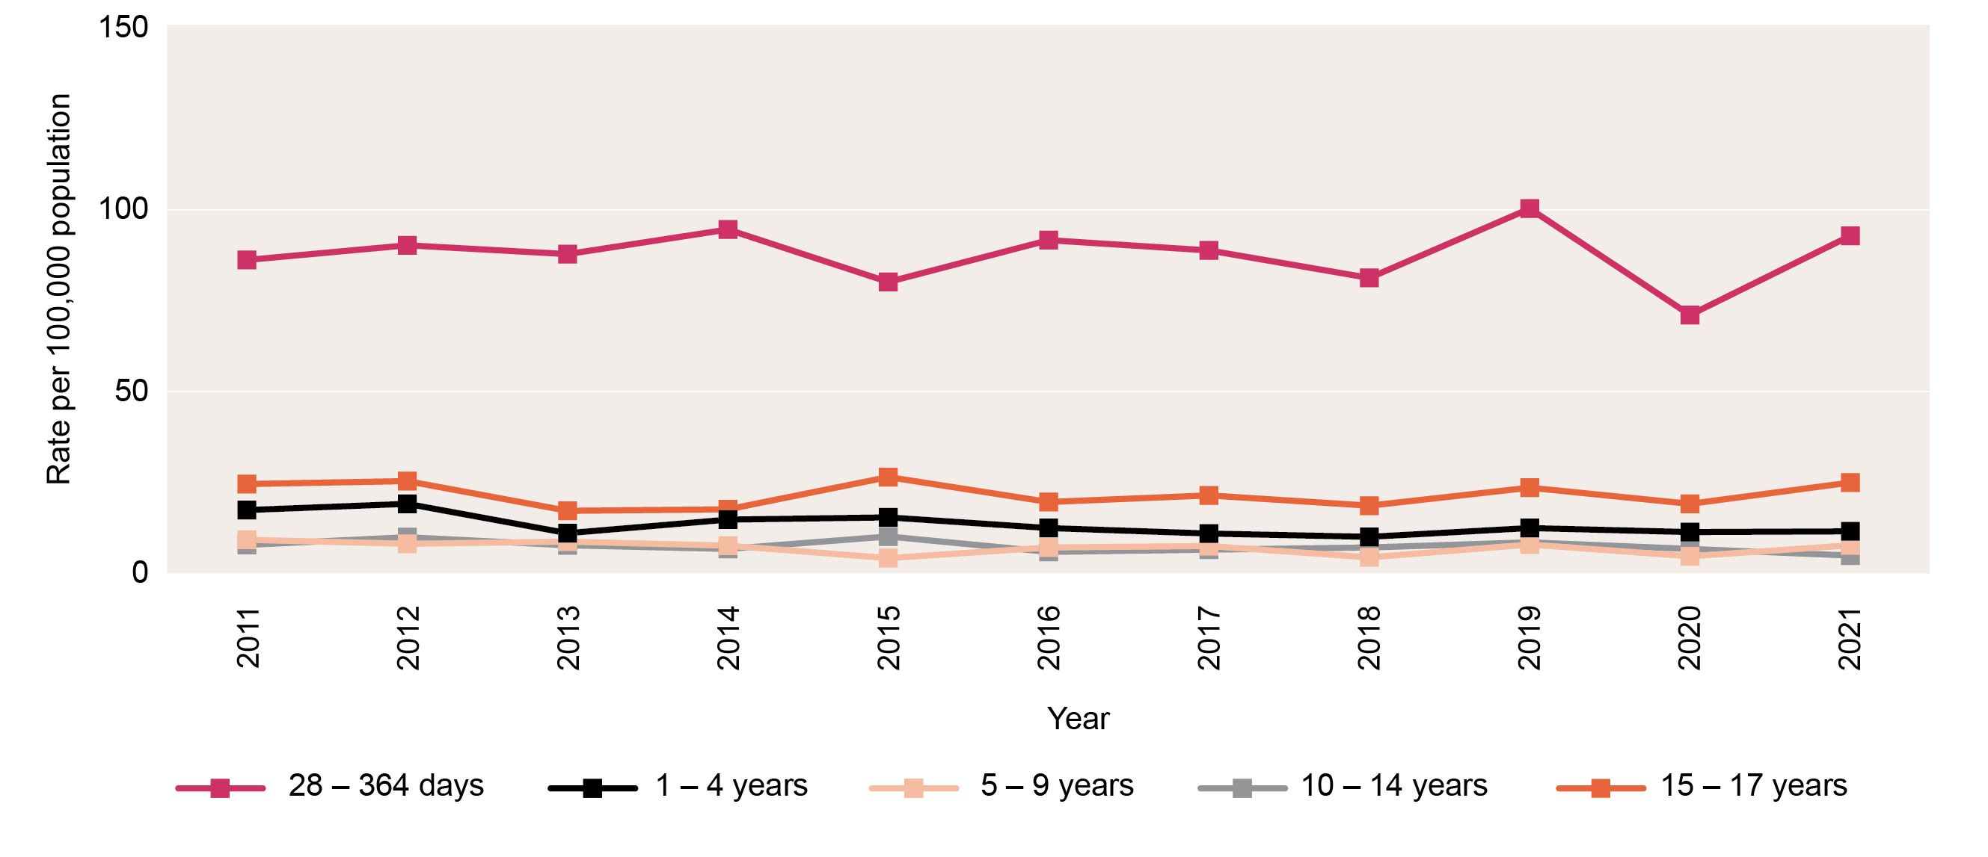
Rates of death by age group, 2011-2021

Slide 13
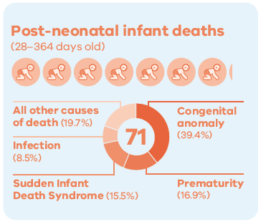
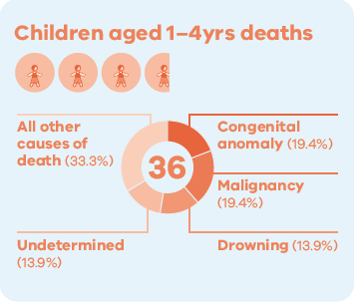
Causes of death in 2021 - Under 5 years

Slide 14
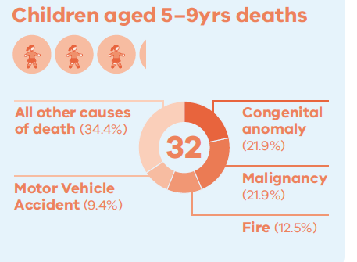
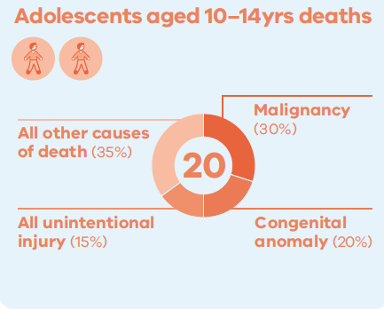
Causes of death in 2021 – 5-14 years

Slide 15
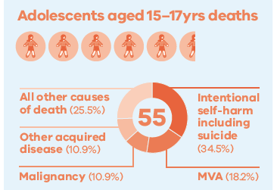
Causes of death in 2021 – 15-17 years

Slide 16
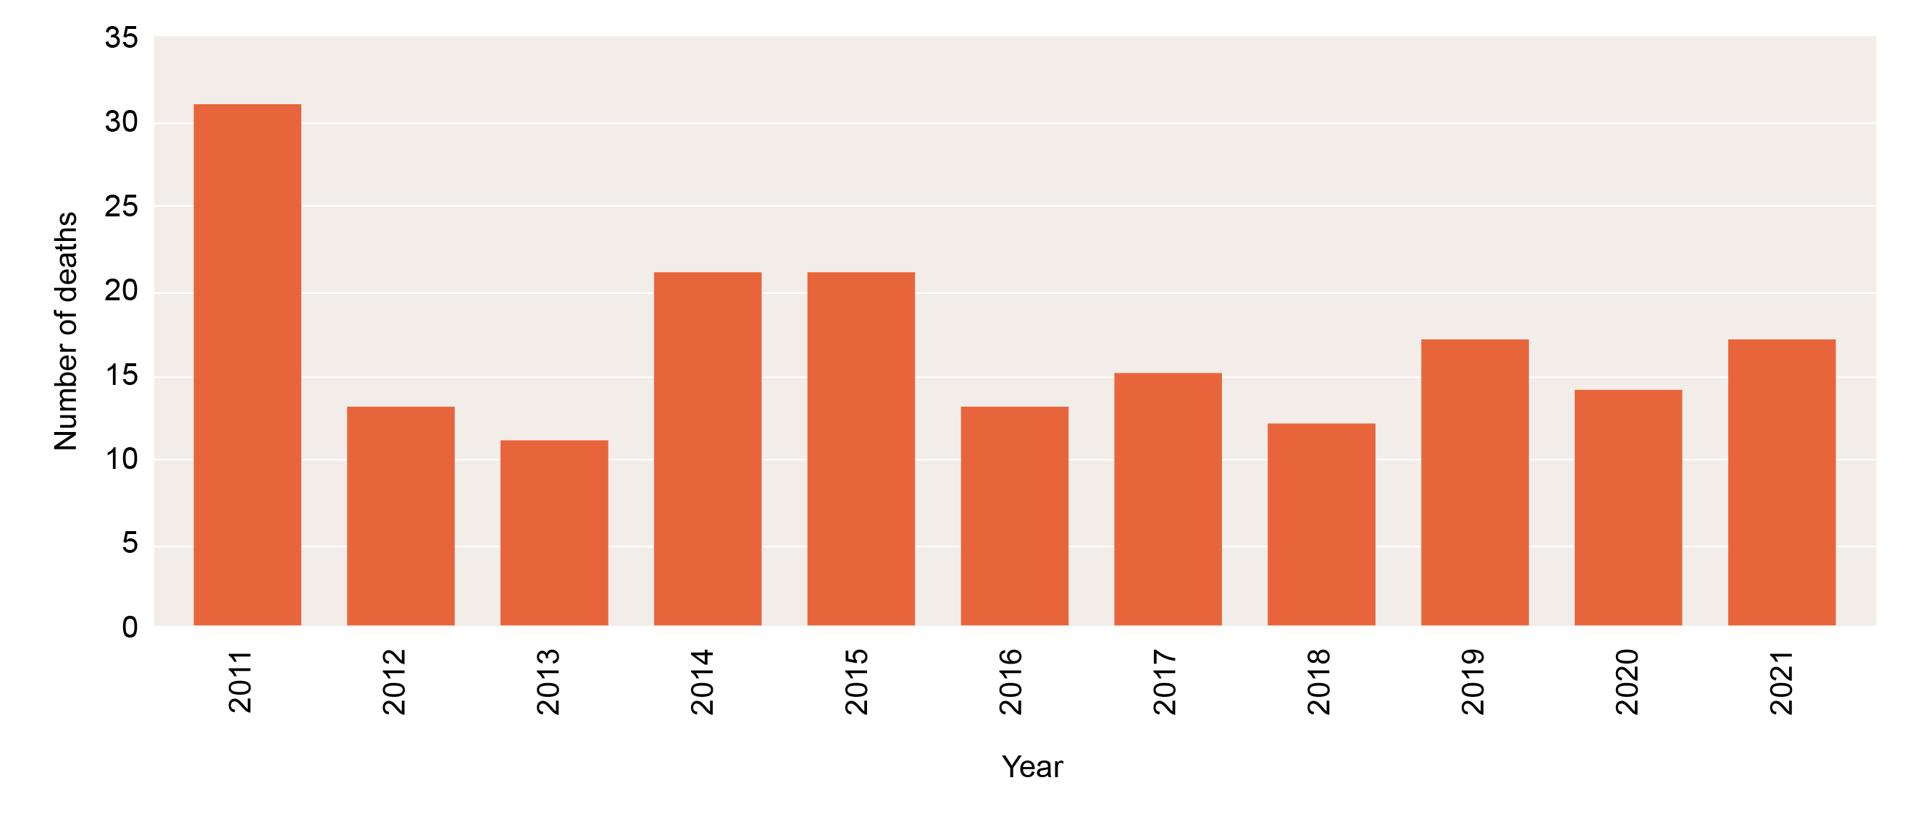
Deaths from motor vehicle accidents 2011-2021 (28 days to 17 years)

Slide 17
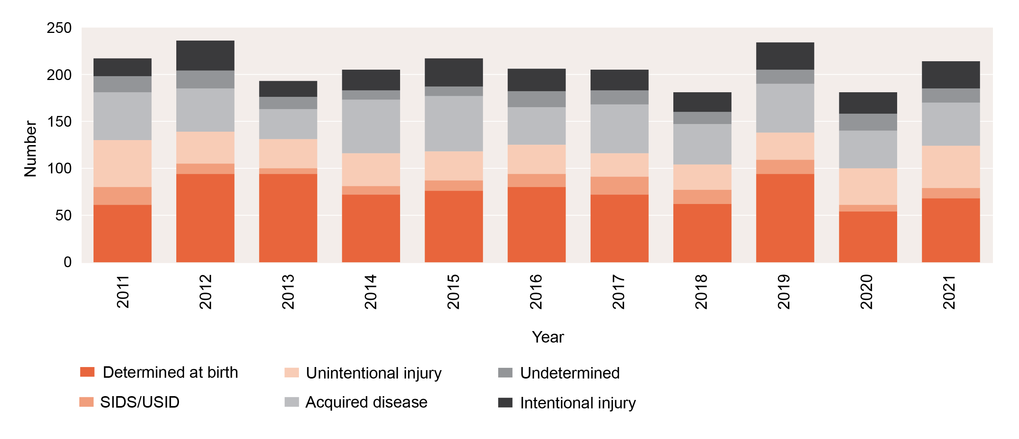
Deaths from major cause, 2011-2021 (28 days to 17 years)

Slide 18
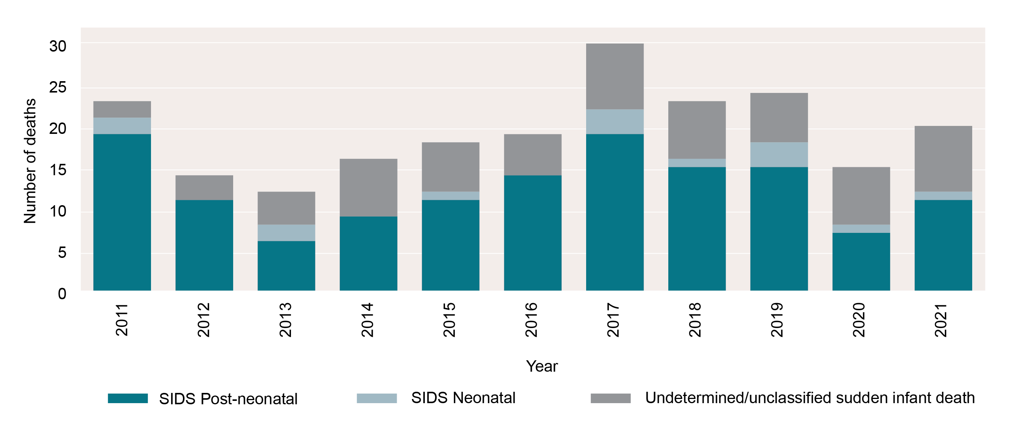
Unexplained sudden unexpected deaths in infants, 2011-2021

Slide 19
CCOPMM recommendations: Child and adolescent

Slide 20
Recommendation 1
The Victorian Government funds whole exome sequence testing for families of children who have died from undiagnosed conditions. Whole exome sequencing (WES) can be useful in identifying a cause, however the cost of this can be prohibitive for some families.
Recommendation 2
Support Health Literacy and Shared Decision-Making Capability
Expectant mothers should be provided with the tools required to make informed decisions about their own care. CCOPMM recommendations have previously focused on improving the functioning of the healthcare system. It is essential to recognise the importance of health care literacy on the outcomes of expectant mothers and families.
Notes:
Recommendation 1
The Victorian Government funds whole exome sequence testing for families of children who have died from undiagnosed conditions. Whole exome sequencing (WES) can help identify a cause, but the cost can be prohibitive for some families. The main conditions for WES include:
neuromuscular diseases
syndromic cardiovascular malformations
hypertrophic cardiomyopathy
skeletal malformations and/or dysplasia
neonatal cholestasis and liver failure
cystic renal disease
metabolic disorders with lactic acidosis
immunodeficiency or bone marrow failure
sudden unexpected death in infancy that is not explained by environmental or other conditions
necrotising encephalitis.
Recommendation 2
Support health literacy and shared decision-making capability.
Expectant mothers should be provided with tools to make informed decisions about their own care. CCOPMM recommendations have previously focused on improving the functioning of the healthcare system. It is essential to recognise the importance of healthcare literacy on the outcomes of expectant mothers and families.
Improvements in health literacy is required in:
improving clinician and consumer awareness of the safety and benefits of vaccination in preventing serious perinatal mortality and morbidity
improving women’s awareness, during the childbearing years, of accessing early pregnancy care, including awareness of painful abdominal symptoms or bleeding and the consideration of an ectopic pregnancy
the need for a multimedia program that supports clinicians to communicate effectively and support shared decision making
the need to alert consumers to the increased risk of sudden unexpected death in infants when family are sleeping at different locations while on holidays or visiting family
understanding the choices behind ‘free birthing’ and providing education/support.

Slide 21
Recommendation 3
Malnutrition in children is a high-risk factor for morbidity and mortality. There is an urgent need to strengthen Primary Health care systems, including Maternity, Maternal and Child Health and General Practice services to detect, monitor and treat malnutrition, especially in vulnerable families.
Recommendation 4 – update to 2017 recommendation
Consider admission of an infant, child or adolescent who has presented three times to a hospital
Notes:
Recommendation 3
Malnutrition in children is a high risk factor for morbidity and mortality. There is an urgent need to strengthen primary healthcare systems including maternity, maternal and child health and general practice services to detect, monitor and treat malnutrition, especially in vulnerable families.
CCOPMM has seen several deaths in the 0–4- year age (children) from malnutrition and its complications. These deaths occurred within vulnerable and marginalised families who were either minimally or not at all engaged with maternal and child health nurse services and general practitioners. The limited face-to-face consultations with primary care providers and a lack of recorded weight and growth monitoring resulted in these children suffering unrecognised severe malnutrition.
When nutritional status is borderline, severe acute malnutrition and death can occur within a few weeks if a child is underfed. For children who are living in high-risk social environments where they are vulnerable to neglect, growth monitoring and assessment of risk are essential. The mortality rate of children with severe malnutrition is high. Severe malnutrition may be complicated by sepsis, hypoglycaemia, hypophosphataemia, hypothermia and dehydration.
Areas for improvement include:
in-person appointments – telehealth consultations are a barrier to recognising failure to thrive and/or severe malnutrition because physical observations and growth monitoring cannot be adequately completed
awareness of the complications of syringe-feeding babies – although widespread, it potentially clouds recognition of a baby’s incapacity to suck feed, which needs to be considered when there are growth concerns
diagnosis awareness – in a highly developed country, the diagnosis of malnutrition is less considered than other causes of poor growth
strengthening the transition of care from maternity to maternal and child health services
strengthening the flagging tool for maternal and child health nurses and general practitioners that identifies vulnerable families and prioritises them for appointments and follow-up if they fail to attend booked appointments
referral to Child Protection if families disengage with services and there is a risk of malnutrition that can result in morbidity and mortality.
Community service agencies involved following a Child Protection referral should ensure there is support for families to remain engaged. If they disengage then referral back to Child Protection is necessary. Across all types of deaths and all age groups, CCOPMM continues to observe an overrepresentation of children from vulnerable families. CCOPMM is concerned that the recent increase in economic pressures on families will worsen this problem.
Recommendation 4 – update to 2017 recommendation
Consider admitting to hospital an infant, child or adolescent who has presented three times to a hospital.
Repeat presentation to any health service during the same acute illness is a red flag.
Repeated presentations (that are not planned reviews) may indicate:
The child is deteriorating.
The child is developing complications (for example, secondary bacterial infection with viral illness).
The severity of the illness has not been appreciated by healthcare staff and/or the diagnosis needs to be reviewed.
The parents or caregivers are extremely concerned about their child.
Parents often seek health care from several health services, especially when they are very concerned. It is important to establish how many times a child has presented for the same illness.
A child who presents a second time for the same acute illness should be reviewed by a senior doctor.
If the child presents unexpectedly for a third time during the same illness, there should be serious consideration for hospital admission, even if the child does not look unwell at the time.

Slide 22
Good practice points
Good practice points (GPPs) reflect the findings of CCOPMM’s review of all cases of maternal, perinatal and paediatric mortality, and severe acute maternal morbidity in a reporting year
They are designed to guide local improvements in clinical performance and can relate to our clinical care and/or the system or service we work in.

Slide 23
Good practice points: systems and/or processes
Drawing up unfamiliar drugs
Imaging for children with dental braces
Managing children with development challenges and difficulty communicating
Please note: Full versions of these GPPs are in the notes below
Notes:
Drawing up unfamiliar drugs
CCOPMM has reviewed cases where dosing errors have occurred with drawing up drugs and / or transfusions. This is particularly likely with drugs that are infrequently prescribed and with which staff are less familiar.
Health services and staff should consider strategies to reduce the likelihood of such errors occurring. These may include:
Locating drawing up locations in quieter areas where staff are less likely to be disturbed
Not interrupting staff who are in the middle of drawing up and checking drugs or infusions
Some centres arrange for very uncommonly used infusions to be drawn up in the hospital pharmacy rather than by staff on the ward
Clinical staff should also note that although double checking and signing for drugs is a legal requirement, there can be pressure to “check” in too cursory a manner. By signing, you are verifying that you have independently checked the dosage and calculations, so it is important for all staff to check dosage as independently as possible, to speak up if in disagreement and to call in another staff member if you are not sure.
Imaging for children with dental braces
Dental braces and other orthodontic attachments are not always a contraindication to CT or MRI scans of the head and neck.
If there is clinical concern of serious pathology the case should be discussed with a radiology consultant, as radiographers are able to use techniques to reduce metal artefact and improve image quality. If the images are insufficient to answer the clinical question, then the risk/benefit of hardware removal and repeating imaging must be considered.
Managing children with development challenges and difficulty communicating
Providing care to children and adolescents with a neurodisability / neurodiversity requires a clear understanding of that individual child’s functional level – their motor ability, their cognitive ability and especially their communication ability and style.
An understanding of how a child expresses pain is a key to recognising and responding to clinically important symptoms and signs. Asking about a child’s communication should be an essential part of every clinical assessment and will inform clinical care.

Slide 24
Good practice points: clinical
Urgent ventilation when anaphylaxis does not respond to adrenaline
Adrenaline injector device for all adolescents with specific food allergies or comorbidities
Early recognition of meningoencephalitis
Please note: Full versions of these GPPs are in the notes below
Notes:
Urgent Ventilation when anaphylaxis does not respond to adrenaline
In a child with anaphylaxis or asthma who is unconscious and needing bag and mask ventilation (i.e., in respiratory arrest), there is a need for urgent intubation, not other forms of respiratory support. Intubation by a skilled anaesthetist, intensivist, emergency physician, or MICA paramedic should occur within 4 minutes.
Adrenaline is the primary treatment for anaphylaxis, but in the event of arrest the sole-reliance on adrenaline, (or other interventions like defibrillation) and delaying intubation will lead to prolonged hypoxaemia and its consequences. It takes 4 minutes of hypoxia after an arrest for irreversible death of brain cells, so intubation cannot be delayed.
Several factors may lead to delayed intubation in such cases. These are trends in emergency management: in adult/mixed hospitals the success of defibrillation for VF has led to people to de-emphasise airway in the treatment algorithms; the successful use of non-invasive methods of respiratory support in many respiratory conditions where the patient is awake encourages an escalation ladder, which is not appropriate in a patient in arrest; and the general success of adrenaline in anaphylaxis leads people to delay airway management in cases of arrest.
Adrenaline injector device for all adolescents with specific food allergies or comorbidities
Adolescents with a food allergy and/or comorbidities should be prescribed an adrenaline injector device. It is important to regularly renew their anaphylaxis action plan, optimise management of their comorbid conditions and emphasise the importance of always carrying their adrenaline injector device.
Adrenaline injector devices are considered first line emergency treatment for anaphylaxis.
Emphasis is made to the cohort of patients who are at risk of fatal anaphylaxis which would include:
Teenagers and young adults with food allergy. While food allergy is most common in young children aged 5 years or less, the majority of recorded fatal reactions to foods (~90%) occur in teenagers and young adults. This is likely to related to greater risk-taking behaviour, increased accidental exposure to food allergens when eating away from home, and less adherence to carrying their adrenaline autoinjectors and following management plans.
Peanut, tree nuts and seafood. Fatal anaphylaxis may arise from any food, but most fatalities arise from food allergy that persists into adolescence and adult life i.e.: nut and seafood allergies.
Co-morbidities – Conditions such as moderate severe asthma, cardiovascular disease and systemic mastocytosis are associated with a greater risk of fatal anaphylaxis.
Early recognition of meningoencephalitis
Many children have febrile convulsions and recover within an hour to normal conscious state and normal neurological examination. Distinguishing these febrile children who have a self-resolving benign condition from those who have more serious CNS infections requires careful and repeated examination.
In recent years we have seen several deaths from fulminant necrotising encephalitis in previously well children, related to influenza, HHV6, enterovirus and human metapneumovirus. Despite pneumococcal vaccination, we are still seeing children with pneumococcal serotypes that are not included in the vaccine.
Children with serious necrotising encephalitis present with seizures, high fever and abnormal neurological examination and progression or lack of resolution of neurological signs.
Clinical assessment
Assess the conscious state (measure and document the Glasgow Coma Score), examine for hypertonicity, ankle clonus, eye deviation, pupillary abnormalities (a dilated pupil, difference in pupil size, or lack of reaction to light). Hyper-pyrexia (T>39 C), abnormal neurology, or failure to improve in the first hour are signs of serious CNS infection and requires urgent escalation. Such a child should be seen by a specialist paediatrician or emergency physician and discussed urgently with PIPER.
Do not assume a child has a febrile convulsion if they do not recover in the first hour. Listen to parents if they say their child remains “not right”.
Management implications
Identification of serious CNS infection should trigger further investigations, as well as consideration of general intensive and neuroprotective treatments:
Airway, breathing and circulation support
Antibiotics – ceftriaxone for bacterial meningitis, and acyclovir for herpes encephalitis, and add flucloxacillin if the child has signs of generalised sepsis
Corticosteroids – dexamethasone 0.15mg/kg Q6H
Neuroprotection: 30° head up, a cerebral perfusion pressure of 40-60mmHg (age dependent), avoiding excessive BP or CPP, serum Na+145-150mmol/L, PaCO2 35mmHg, 30° head up
Active cooling to T<38 C
Follow the RCH Clinical Practice Guidelines for investigations of possible meningitis:https://www.rch.org.au/clinicalguide/guideline_index/Meningitis_encephalitis/
Early use of MRI-B will identify changes not detected by CT. On MRI children with necrotising encephalitis have symmetrical changes often involving the thalami, basal ganglia, brain stem and / cerebellum.
Tertiary referral centres may consider antiviral agents to target influenza (Oseltamivir) and HHV6 (high-dose ganciclovir) which will also cover HSV
Referral for future genetic testing to identify any susceptibility if necrotising encephalitis identified. Some children with necrotising encephalitis have a genetic predisposition to mitochondrial stress in the setting of a viral infection (Levine JM, et al. Multiple Sclerosis and Related Disorders 2020: 43; 102194 p1-8).
The differential diagnosis of acute febrile encephalopathy is broad, so other investigations are important to exclude cerebral abscess, acute disseminated encephalomyelitis (ADEM), and autoimmune encephalitis, as well as other non-infectious causes.

Slide 25
Good practice points: consumers
Unfamiliar sleep sites for infants
Managing illness on school trips
Please note: Full versions of these GPPs are in the notes below
Notes:
Unfamiliar sleep sites for infants
It is important to make every sleep for a baby a safe one. Safe sleeping may be overlooked when in unfamiliar settings such as holidays or visiting other homes.
When travelling with a baby, a portable cot (that meets Australian standard 2195:2015 folding cot) is recommended. If staying in accommodation or with friends or family, call ahead to check that the loan cot or port-a-cot your baby will be sleeping in meets Australian standards and is in excellent condition.
A baby should never be put down to sleep on a sofa, bean bag, sheepskin, or pillow. There is no Australian standard for bassinettes.
The safest place for a baby to sleep is in a safe cot that meets the Australian Standard AS2172:2003, with a clean firm flat mattress that is the right size for the cot and meets voluntary Australian standard (AS/NZS 8811.1:2013). The cot should not be tilted or elevated. The mattress should be covered with only a tightly fitted sheet and, if required, a thin tightly fitted mattress-protector under the fitted sheet.
In addition, when travelling, take a range of sleep wear (clothes, sleeping suits, bedding) to suit variations in climate to avoid a baby overheating in unfamiliar environments.
Resources:
https://rednose.org.au/article/what-is-a-safe-sleeping-environment
https://rednose.org.au/article/red-nose-six-safe-sleep-recommendations
https://rednose.org.au/article/setting-up-a-safe-nursery-what-products-do-you-really-need
https://rednose.org.au/news/going-away-keep-your-baby-safe-while-away-from-home
Managing illness on school trips
Parents and carers know their children best. When young people are in the care of others and become unwell there is a risk of under-recognition or an inadequate response. This risk is increased for children with pre-existing illness.
Prior to travel students with chronic illness should attend their specialist or general practitioner to:
ensure their condition is well managed
decide if any changes in the management are required during the trip
develop an individual healthcare plan which states what care and monitoring they need and which members of staff will help them
When a student becomes unwell all members of staff on the trip should:
be aware of the student’s condition
monitor signs of the student becoming more unwell
have a plan for what to do in the case of an emergency (a written escalation plan is recommended for many pre-existing conditions).
arrange an online face-to-face meeting with the child’s parents and the child to discuss healthcare management.

Slide 26
For more information
https://www.safercare.vic.gov.au/reports-and-publications/victorias-mothers-babies-and-children-2021-report-and-presentations
Refer to CCOPMM’s other slide packs on:
Mothers and babies
Maternal mortality and morbidity
Perinatal mortality
2020 recommendations

Slide 27
Connect with us
https://www.safercare.vic.gov.au/about/ccopmm,
ccopmm@safercare.vic.gov.au
@safercarevic
Safer Care Victoria

