Slide 1



Victoria’s mothers, babies and children 2021
Maternal Mortality and Morbidity

Slide 2


About CCOPMM
    The Consultative Council on Obstetric and Paediatric Mortality and Morbidity (CCOPMM) is a statutory authority appointed by the Minister for Health.
Chair: Professor Mark Umstad AM
Operates under the Public Health and Wellbeing Act 2008

Slide 3
About CCOPMM
    Legislative responsibility for data collection:
    Victorian Perinatal Data Collection (VPDC)
    Victorian Congenital anomalies register (VCAR)
    Legislative responsibility for health surveillance:
    Mortality collections and review of perinatal, child and adolescent, and maternal mortality
    Morbidity collections: severe acute maternal morbidity (SAMM)

Slide 4
Undertaking case reviews
CCOPMM has four subcommittees that undertake case reviews and report to CCOPMM.
    Stillbirth – Chair: Professor Susan McDonald
    Neonatal (0-27 days) – Chair: Professor Rod Hunt
    Maternal– Chair: Assoc. Prof. Glyn Teale
    Child and Adolescent (28 days-17 years) – Chair: Adjunct Clinical Associate Professor Rob Roseby

Slide 5
Undertaking research
CCOPMM conducts research itself and provides data for research purposes. The CCOPMM Research and Reporting subcommittee leads this work - Chair: Professor Caroline Homer.
CCOPMM identifies research priorities by:
    analysis of our reports, data and through case reviews
    collaborating with external research projects

Slide 6
Why we do what we do?
Independent oversight of all deaths and severe maternal morbidity
Highlight areas that require improvement – hospital and community
Highlight areas for further research
Inform the development of policies and guidelines
Provide advice on areas for prioritisation and investment

Slide 7

Maternal mortality and morbidity

Slide 8
Maternal mortality and morbidity
    Include:
    All maternal deaths during pregnancy and within a year of birth
    All intensive care unit (ICU) admissions during pregnancy and up to 42 days after birth or pregnancy end.

Slide 9
Maternal mortality and morbidity
Maternal deaths occurring during pregnancy or within 42 days of the end of pregnancy are classified as:
    Direct – relating to the pregnancy or birth
    Indirect – relating to a pre-existing medical condition or newly diagnosed condition
    Coincidental – unrelated to the pregnancy or birth
    Maternal deaths occurring after 42 days following pregnancy and up to one year post birth are classified as late.

Slide 10
Maternal mortality ratio (MMR)
The incidence of maternal deaths is expressed as the maternal mortality ratio (MMR), which is calculated using direct and indirect deaths combined, and excludes coincidental deaths (AIHW).
This includes direct and indirect deaths that occur during pregnancy or within 42 days of the end of pregnancy.

Slide 11
Severe Acute Maternal Morbidity (SAMM)
SAMM is measured as an admission to an ICU during pregnancy and up to 42 days after birth.
The criteria for ICU admission may vary across hospitals, and not all maternity services in Victoria have direct access to an ICU.

Slide 12
Trends and comparisons

Slide 13
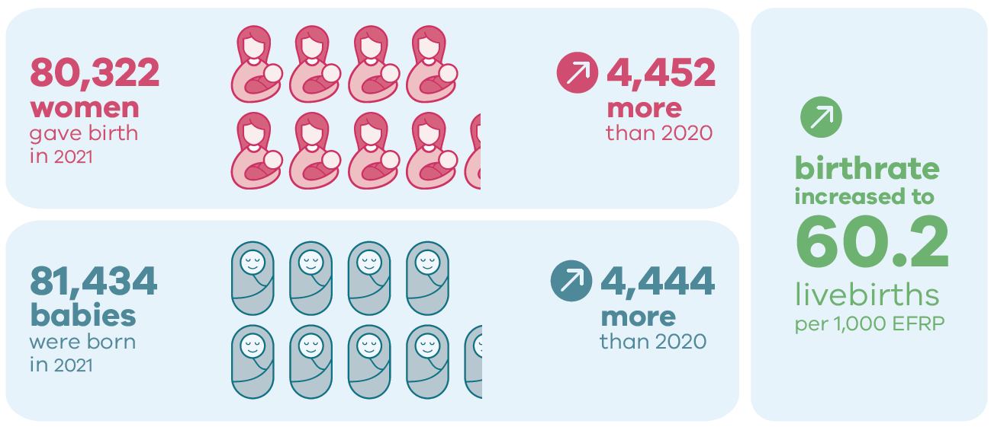
Births in 2021

Slide 14

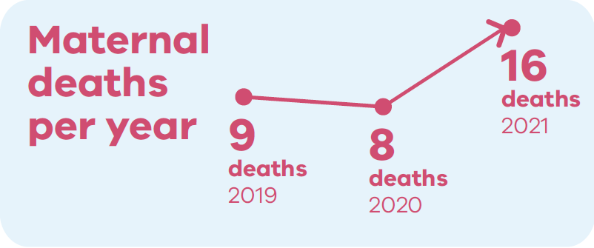
Maternal mortality: 2019 to 2021

Slide 15
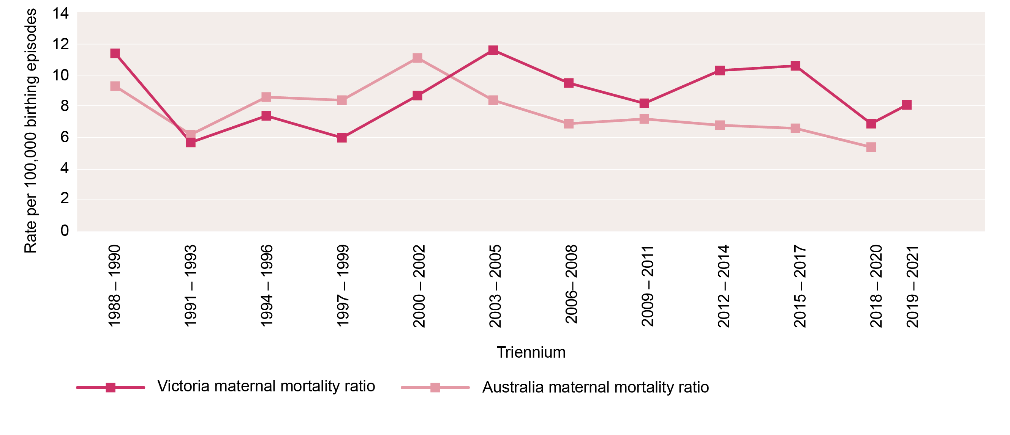
Maternal mortality ratios: Rolling triennia

Slide 16

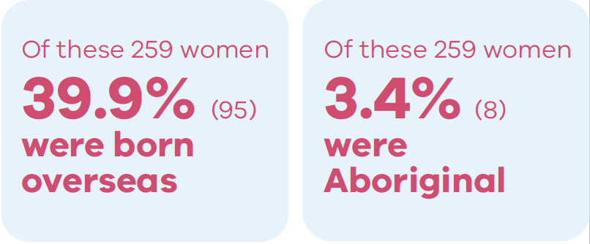
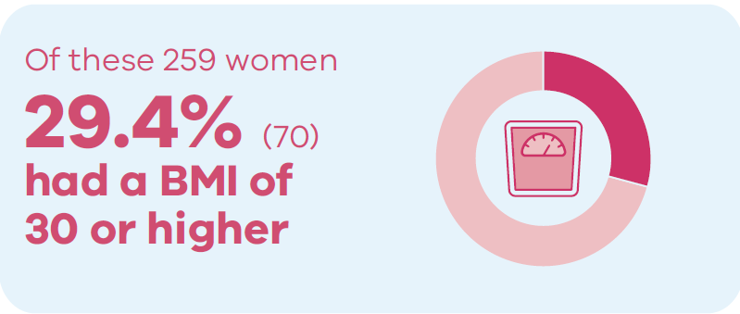
Severe Acute Maternal Morbidity (SAMM) in 2021

Slide 17
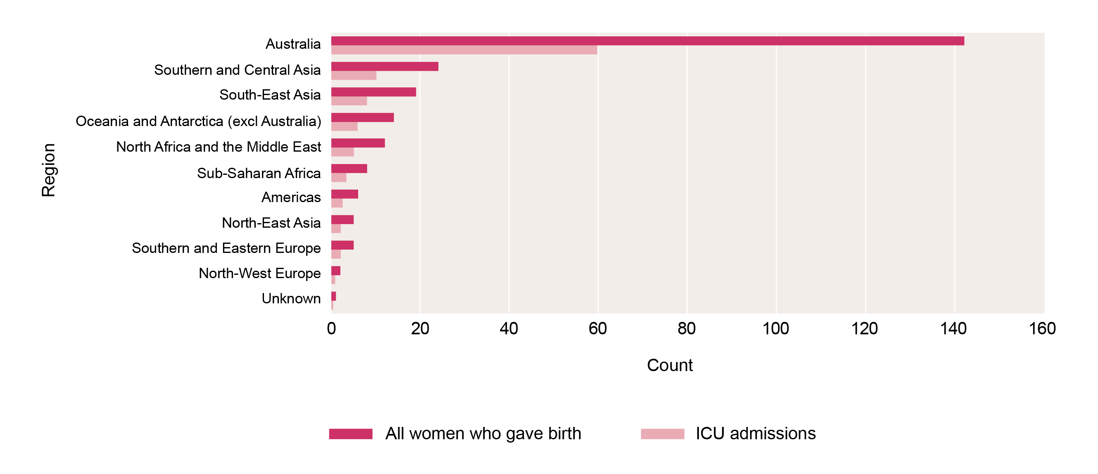
Proportion of maternal ICU admissions by region of birth compared with all women who gave birth, 2021

Slide 18
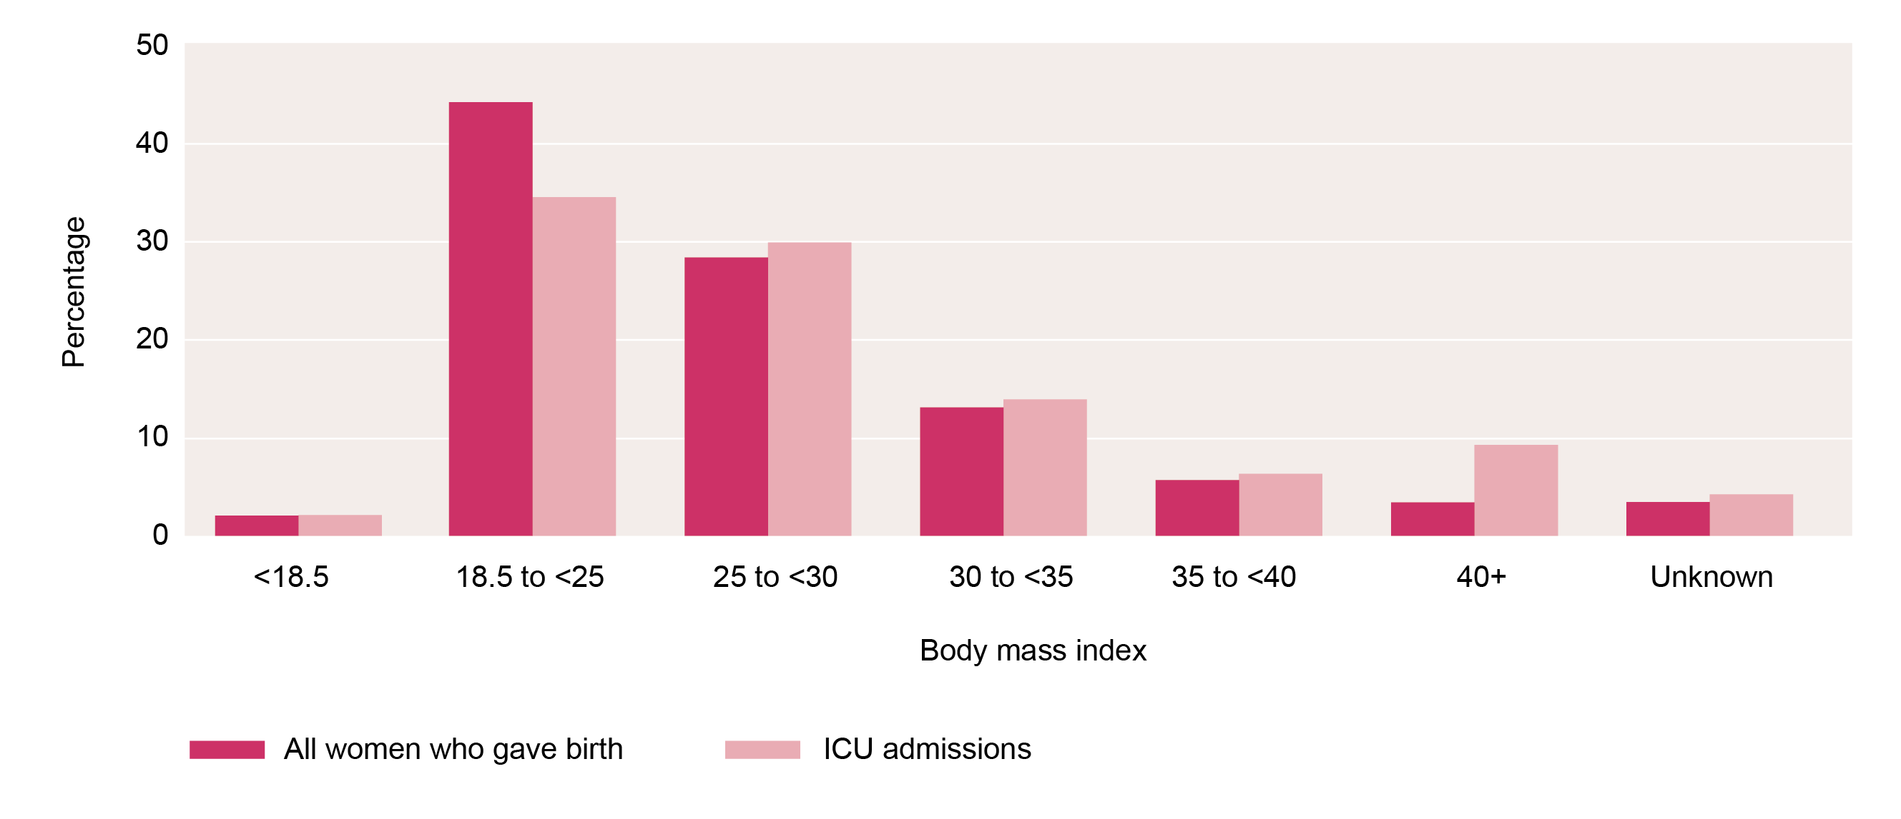
Proportion of maternal ICU admissions by BMI categories compared with all women who gave birth, 2021

Slide 19
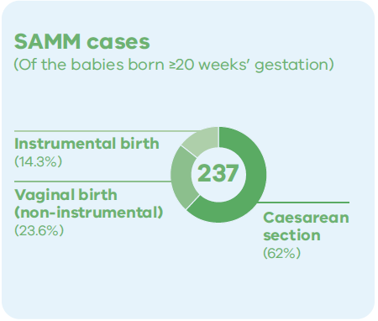
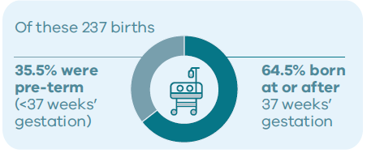
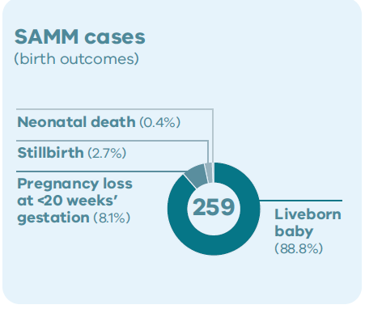
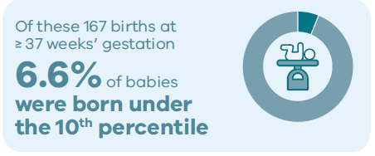
Birth Outcomes (SAMM cases) in 2021

Slide 20
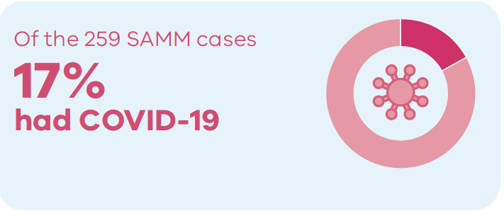
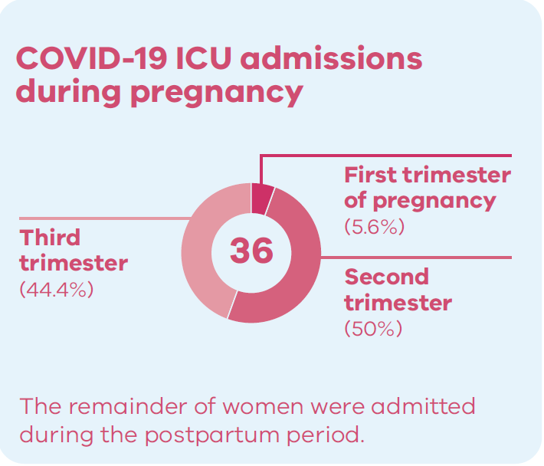
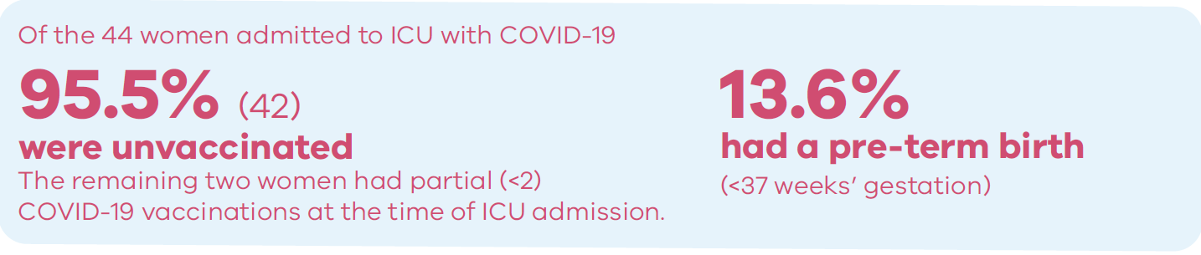
Covid-19 (SAMM cases) in 2021

Slide 21
CCOPMM Recommandation: Maternal
Support Health Literacy and Shared Decision-Making Capability
Expectant mothers should be provided with the tools required to make informed decisions about their own care. CCOPMM recommendations have previously focused on improving the functioning of the healthcare system. It is essential to recognise the importance of health care literacy on the outcomes of expectant mothers and families.
Notes:
Recommendation
Support health literacy and shared decision-making capability.
Expectant mothers should be provided with tools to make informed decisions about their own care. CCOPMM recommendations have previously focused on improving the functioning of the healthcare system. It is essential to recognise the importance of healthcare literacy on the outcomes of expectant mothers and families.
Improvements in health literacy is required in:
improving clinician and consumer awareness of the safety and benefits of vaccination in preventing serious perinatal mortality and morbidity
improving women’s awareness, during the childbearing years, of accessing early pregnancy care, including awareness of painful abdominal symptoms or bleeding and the consideration of an ectopic pregnancy
the need for a multimedia program that supports clinicians to communicate effectively and support shared decision making
the need to alert consumers to the increased risk of sudden unexpected death in infants when family are sleeping at different locations while on holidays or visiting family
understanding the choices behind ‘free birthing’ and providing education/support.

Slide 22

Good practice points
Good practice points (GPPs) reflect the findings of CCOPMM’s review of all cases of maternal, perinatal and paediatric mortality, and severe acute maternal morbidity in a reporting year
They are designed to guide local improvements in clinical performance and can relate to our clinical care and/or the system or service we work in.

Slide 23
Good practice point 1
Where there is heavy vaginal bleeding in the presence of a miscarriage early surgical management should be initiated to reduce the likelihood of clinical deterioration and the need for blood transfusion.

Slide 24
Good practice point 2
All women admitted with a pregnancy complication or readmitted in the postnatal period are reviewed by a senior clinician within 24 hours of admission.

Slide 25
Good practice point 3
Expand the use of multidisciplinary simulation training to improve the management of epidural complications including maternal collapse and maternal deterioration from sepsis.

Slide 26
Good practice point 4
The care of all women with suspected or confirmed mid-trimester preterm premature rupture of membranes (PPROM) at the limits of viability should involve a senior obstetric clinician. Where there is consideration of terminating a pregnancy, timely multidisciplinary discussion is recommended.

Slide 27
Good practice point 5
The Maternal subcommittee recommend that all women meeting criteria for severe acute maternal morbidity (SAMM) reporting are reviewed internally by the health facility to identify learning opportunities. This review is shared within 3 months with the Maternal subcommittee.

Slide 28
For more information
https://www.safercare.vic.gov.au/reports-and-publications/victorias-mothers-babies-and-children-2021-report-and-presentations
Refer to CCOPMM’s other slide packs on:
Mothers and babies
Maternal mortality and morbidity
Perinatal mortality
2020 recommendations

Slide 29




Connect with us
https://www.safercare.vic.gov.au/about/ccopmm,
ccopmm@safercare.vic.gov.au
@safercarevic
Safer Care Victoria

